Slide 1



Merck Animal Health Forecasting Project Cornell University - Final Presentation
May 2016

Slide 2
Agenda Demand Forecasting
Topic | Presenter | Time
Overview Introduction Project Charter | Benjamin E. | 10min 5min
2. Methodology | Benjamin E. | 10min
3. Executive Summary Mature product insights New product insights | Anqi H. | 20min
4. Mature Product | Shuang W. | 20min
5. New Product | Abhishek D. | 20min
6. Wrap-Up | Abhishek D. | 5 min
Notes:
B

Slide 3
Project Charter Demand Forecasting
Project Description
While a forecasting system has been deployed to Merck Animal Health (MAH) US, users are in varying degrees of system adoption and some are still calculating sales and demand forecasts using MS Excel based on historical experience and judgment. The manual calculations are then entered into the system. Management would like to verify whether the system forecasts are reflective of the real demand based on market data.
Scope and Deliverables
Targeted Business Value
For selected products:
Design and build analytical forecasting model based on multiple drivers
Calculate forecasts using the model
Summarize key insights and recommendations
Inform sales and finance strategy and planning
Input to production planning to optimize production capacity based on real market demand
Optimize revenue by preventing stock outs on SKUs with real market demand
Avoid cost from carrying excess inventory of SKUs without real market demand
Key Stakeholders
IT (Analytics and Supply Chain)
Product Managers
Supply Chain
Finance
Data Information
Estimated Level of Effort
Data Sources: Global Data Hub for sales in and sales out, Market Research, Forecasting system for current forecasts, Financial system for current inventory on hand at the warehouse
Period Covered: 2013-2014
Timeframe: Jan 2016 – May 2016
Key Resource/s: Tushar K (Project Manager),
Sijia G (Delivery Lead), Kris I, Anqi H, Shuang W, Abhishek D,
Benjamin E

Slide 4


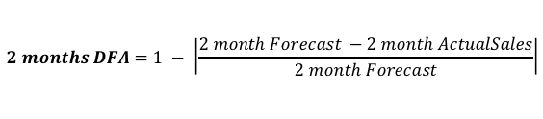
Methodology Approach for Modeling
Process Flow:
Analytics Approach
Determine Product/SKU
Gather Data
Forecast Sales Out
Forecast Sales In
Collect Results
Develop an advanced analytical forecasting model based on multiple drivers, such as market trend and seasonality, using external market data and internal sales and inventory data
Validate the model by applying the model on historical data, and overlaying it with the actual market data trend for the same period
Calculate forecast for product demand
Summarize results, key insights and key recommendations
Nobivac:
Mature Product
Activyl: Newly Launched Product
Sales Out
Sales In
GFK: Total Market Shipment
Inventory
Accuracy Metrics:
$$2 months DFA=1 − \left|\frac{2 month Forecast −2 month ActualSales}{2 month Forecast}\right|$$
$$4 months Weighted Average Error \left(WAE\right)= \\ \frac{[Error(1st Month) + Error(2nd Month)/2 + Error(3rd Month)/4 + Error(4th Month)/8]}{1.875 }$$
$$Where Error\left(month\right)= \left|\frac{1 month Forecast −1 month ActualSales}{1 month Actual}\right|$$
Forecast Sales-Out:
GFK data
Forecast Sales-In:
Forecasting Model For Sales In
External Market Data
Inventory
Historical Sales In
Forecast of Sales Out
External Market Data
Historical Sales Out
Forecasting Model For Sales Out
Granger Causality Test:
Determine input factors
Cross-validation:
Training Set
Validation Set
=> To choose the best combination of factors
Notes:
Trend and Seasonality of historical data are considered in each forecasting model
Sales out : explain the different possible combinations

Slide 5
Executive Summary
Key Results and Insights
Mature Product - Nobivac
New Product - Activyl
Tool used: Statistical software R, MS Excel
Data requirements:
Need at least 25-month availability of accurate Sales In, Sales Out, Inventory Status, and External Market Data
Used 31-month data to forecast 10-month Sales Out and 10-month Sales In
(comparison made on 4-month Sales out and 8-month Sales In)
Modeling technique used for Sales In and Sales Out:
Need to capture seasonality and trend of historical data
Need to include external factors
Clustering technique used for Sales In and Sales Out:
Correlation Analysis of Sales In
SKUs with highly correlated Sales In are clustered together (5 clusters)
3 SKUs have low correlation with all other SKUs’
The model is created at three level of complexity/accuracy
1. One model for each of 31 SKU’s – Accurate but complex
2. Clustered model – Less accurate and complex
3. Single model for all 31 SKU’s – Simple but least accurate
Tool used: Statistical software R, MS Excel
Data requirements:
Need at least 6-month availability of accurate Sales Out, Inventory Status and External Market Data since product launch (Jan 2013)
Used 6-month data to forecast 12-month Sales Out and 12-month Sales In
Modeling technique used for Sales In and Sales Out: Regression
Sales Out Forecast Model: Moving-average with pipeline stage removed
Sales In Forecast Model: Non-linear regression to model the relationship b/w Cumulative Sales In and Cumulative Sales Out before SKU matures
Clustering technique used for Sales In and Sales Out:
Cluster based on Physical Characteristics
By category (3 clusters) - By pack size (2 clusters)
By category and pack size (6 cluster)
The model is created at three level of complexity/accuracy
1. One model for each 24 SKU’s – Accurate but complex
2. Clustered model – Least accurate and complex (bad clustering method)
3. Single model for all 24 SKU’s – Simple and less accurate
Transfer Function Model
(ARIMAX)
Result:
Clustered model to forecast Sales Out based on both historical Sales Out and External Market Data; average monthly DFA achieved 88.3%
SKU-level model to forecast Sales In using different combinations of Historical Sales In, Forecasted Sales Out, External market data, and Inventory Status; average WAE achieved 31%
Insights:
Recommend using clustered model for Sales Out forecast and SKU-level model for Sales In forecast
When forecasting Sales In, SKU category (e.g. Feline, Canine, Rabies, etc.) determines the usefulness of external factors
Limitations and Mitigation Strategy:
Compromised forecast accuracy for highly-seasonal SKUs (e.g. Flu)
Strategy: collect and analyze external data of disease outbreak
Compromised model robustness when BOGO promotions occur
Strategy: estimate period for promotion and build a model specific to it
Results:
A single model for all SKUs to forecast Sales Out based on only historical Sales Out; average monthly DFA improved from 10.7% to 68.4%
A single model for all SKUs to forecast Sales In using forecasted Sales out and the relationship between Sales In and Sales Out; average WAE achieved 8.61%
Insights:
Recommend using a single model for Sales Out and a single model for Sales In Forecasts
Pipeline stage of Sales Out exists for 3 months for all SKUs
SKU type and pack size determines the time needed for the SKU to mature; on average, each SKU needs 16 months
Limitations and Mitigation Strategy:
Questionable validity of the available data
Strategy: make reasonable assumptions; validation across datasets
External market data was not used due to limited data points
Strategy: update and review the model more frequently (every 6 months)

Slide 6
Mature Product Forecast Nobivac Model
Distribution of Weighted Average Metrics across all 31 SKU’s of each level: [ 4-Month Forecast from Aug 2015 to Nov 2015]
Sales Out:
Cluster Level performs the best.
Average WAE 22.0%,
Max 52.51% SKU 65441
Average WAE 18.27%,
Max 42.34 SKU 65284
Average WAE 19.62%,
Max 50.75% SKU 84987
[ 8-Month Forecast from Aug 2015 to Mar 2016]
Sales In:
SKU Level performs the best.
Average WAE 31.17%,
Max 82.86% SKU 54097
Average WAE 51.48%,
Max 142.65% SKU 65444
Average WAE 54.55%,
Max 165.66% SKU 65444
Notice: 3 SKUs to model individually:
- 53260: NOBIVAC® Puppy-DPv: 22.36%
- 54097: NOBIVAC® INTRA-TRAC® KC: 82.26%
- 84987: NOBIVAC® Canine Flu H3N8:77.56%
$$Weighted Average Error = \frac{[Error(1st Month) + Error(2nd Month)/2 + Error(3rd Month)/4 + Error(4th Month)/8]}{1.875 }$$
Notes:
Average across 31 skus + extreme values and corresponding skus

Slide 7
Mature Product Forecast Nobivac Model
Insights:
Recommend using Cluster Level model to forecast Sales Out. SKU or Unionized Level model are not suggested.
Recommend using SKU Level model to forecast Sales In. Clustering or Unionized Level model are not suggested.
Cornell Model vs Actuals & Current Forecast (Across all 31 SKUs)
Forecast Sales Out (Dosage x 100000)
Sale Out
Use Historical Sales Out and External Data
Cluster level forecast capture actual seasonality and trend relatively better than current model.
Average Monthly DFA improved from 75.7% to 88.3%
$$DFA=1 − \left|\frac{2 month Forecast −2 month ActualSales}{2 month Forecast}\right|$$
Forecast Sales In (Dosage x 100000)
Sale In
SKU level forecast capture actual seasonality and trend relatively better than current model.
Average WAE across all 31 SKUs improves from 53.90% to 31.17%.
Model used: Transfer function models (ARIMAX Time Series Forecasting)
Tool used: Statistical Software R
Notes:
Change color, it’s a picture I can’t do it
Make sure its DFA or WA

Slide 8
Mature Product Forecast Nobivac Insights
Sales Out Model
Sales In Model
When forecasting Nobivac, Historical Sales In is the most important driven factor across all 31 SKUs.
Build clustered model based on Historical Sale Out and External Data, which are the driving factors.
Use Sales Out predictions based on the Cluster Level to predict Sales In
Clustered model improves average monthly DFA from 75.7% to 88.3% comparing to current forecasting model.
Sales Out and External Data are useful factors for all SKUs except Feline.
Inventory Status is important to only Feline and Canine.
Model:
Driving Factors:
Recommend using SKU Level model for all 31 SKUs since it tends to outperform the other 2 models (Cluster & Unionized).
Clustering or Unionized Level model are not suggested.
Results:
18 out of 31 SKUs have WAE smaller than 25%.
Average WAE across all SKUs improves from 54% to 31%.
Limitations:
At least 25 months of data are required for both Sales In and Sales Out forecasting models
Highly-seasonal SKUs and special events (e.g. BOGO promotions) are difficult to be forecasted.
1
1
See Appendix 1 – Driving Factors Analysis

Slide 9
New Product Forecast Activyl Model
Average DFA Distribution among 24 SKUs within 12-Month of Prediction
[ 12-Month Forecast from Jul 2013 to Jun 2014]
Error Distribution across all 24 skus of all 3 models are the same:
Sales Out:
Average monthly DFA across all 24 SKUs improves from 10.7% to 68.4%
Average WAE 55.39%, Max 150.74% SKU 11632
Distribution of Weighted Average Metrics across all 24 skus of each level: [ 12-Month Forecast from Jul 2013 to Jun 2014]
Sales In:
Average WAE 6.28%, Max 19.72% SKU 104695
Average WAE 18.1%, Max 311% SKU 117105
Average WAE 8.6%, Max 26.75% SKU 114162
Notice: 4 “Outstanding” SKUs needed to model individually:
115627: ACTIVYL EXTRA LARGE DOGS 6x4.62ML 240
114997: ACTIVYL EXTRA LARGE DOGS 1x4.62ML 240
114162: Activyl Tick plus X-Lg Dog 1x6ml 240
24682: Activyl Tick plus X Lg Dog 6x6ml 240
Insights:
SKU Level Model and Unionized Model outperform similarly.
Due to simplicity, we recommend using Unionized Level model.
Notes:
SO Insights:
Error Rate tends to be relatively higher than Nobivac.This is reasonable considering Activyl is a new product with limited data.
Overall, new model performs better than the current one.

Slide 10
New Product Forecast Activyl Model
Insights:
Recommend using Unionized model to forecast Sales Out.
Recommend using Unionized model to forecast Sales In.
Cornell Model vs Actuals & Current Forecast (Across all 24 SKUs)
[ 12-Month Forecast from Jul 2013 to Jun 2014]
Forecast Sales Out (Dosage)
Sale Out
Use Only Historical Sales Out Data
Our model was not able to capture actual seasonality and trend relatively. However, Average Monthly DFA improved from 10.7% to 68.37%
Forecast Sales In (Dosage)
Sale In
Out model captures actual seasonality and trend relatively better than current model and more accurate than current forecast.
Average WAE across all 24 SKUs is 8.61% including high seasonality SKUs.
Notes:
Current WAE is 1157.3%

Slide 11
New Product Forecast Activyl Insights
Product
Model: A single moving-average model (Unionized level) provides the best forecast.
Model:
Model
When forecasting Sales In, we recommend using Unionized model.
External market data might also be an useful factor. But due to the availability of data, it cannot be incorporated in the model.
Driving factors: Only Historical Sales Out
Result: Average monthly DFA across all 24 SKUs improves from 10.7% to 68.4%
Limitation:
With very few data points available, all three types of model result in the same Sales Out forecasts.
Driving Factors:
Pack size is useful for Cats & Dogs
SKU type is useful for TICK PLUS
Limited predictive power with few data points, and not validated Sales In Data
Both SKU-Level and Unionized model work well.
1
See Appendix 1 – Driving Factors Analysis

Slide 12
Wrap-up
Recap of Executive Summary
For Mature Product Nobivac:
Sales Out Forecast: - Build clustered model based on historical Sale Out and External Data
- Average monthly DFA achieves 88.3%
Sales In Forecast: - Create one model for each SKU, each using the best combination of factors
- Average WAE for 8-month period is 31%
For New Product Activyl:
Sales Out Forecast : - A single model based on historical Sales Out after removing pipeline stage
- Average monthly DFA improves from 10.7% to 68.4%
Sales In Forecast: - A single model to find the relationship between Cumulative Sales In and Sales Out
- Average WAE for 12-month period achieves 8.61%, with 4 SKUs modeled individually.
- SKU category, type, and pack size help to analyze Sales In behavior
Notes:
Clean the data available on git hub

Slide 13
Wrap-up
Next steps
For Mature Product Nobivac: Revisit the model every year or when there is a significant change in the market, update/ adjust as deemed necessary
For New Product Activyl: Revisit modeling approach after the product matures (16 months) based on the expected life of the product
Data purging activity
- Models and analysis will be fully turned over to the team and data will be purged from any repository or tool (GitHub)

Slide 14
Appendix 1 - Nobivac Sales In – Driving Factors Analysis
Insights:
All SKUs use historical SI
SO is used to predict 14 SKUs
Inventory helps forecasting 8 SKUs :
External Data is used for 7 SKUs:
Driving Factors:
SO: Historical Sales Out
SI: Historical Sales In
Inv: Inventory
Ext: External Market Data
SO is used to predict 14 SKU:
NOBIVAC® INTRA-TRAC® KC
NOBIVAC® INTRA-TRAC®3
NOBIVAC® INTRA-TRAC®3 ADT
NOBIVAC® INTRA-TRAC®3 ADT
NOBIVAC® 3-Rabies
NOBIVAC® 1-Rabies
NOBIVAC® 3-Rabies
NOBIVAC® Canine 1-DAPPvL2+CV
NOBIVAC® Canine 3-DAPv
NOBIVAC® Canine 1-Cv
NOBIVAC® Canine 1-DAPPvL4
NOBIVAC® Canine Flu H3N8
NOBIVAC® Lyme
NOBIVAC® Feline 1-HCPCh
NOBIVAC® Feline 3-HCP
NOBIVAC® Feline 1-HCP+ FeLV
NOBIVAC® FeLV
NOBIVAC® Feline 1-HCPCh+ FeLV
NOBIVAC® Canine 1-DAPPvL2
NOBIVAC® Canine 3-DAPv
NOBIVAC® Canine 1-Cv
NOBIVAC® 3-Rabies CA
NOBIVAC® INTRA-TRAC® KC
NOBIVAC® INTRA-TRAC®3 ADT
NOBIVAC® Canine 1-DAPPvL4
NOBIVAC® Canine Flu H3N8
NOBIVAC® 3-Rabies CA
NOBIVAC® 3-Rabies
NOBIVAC® Feline 1-HCPCh
Notes:
W

Slide 15
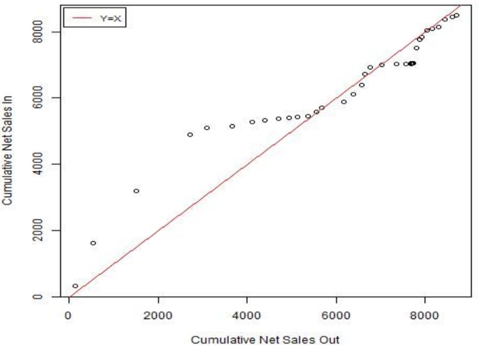
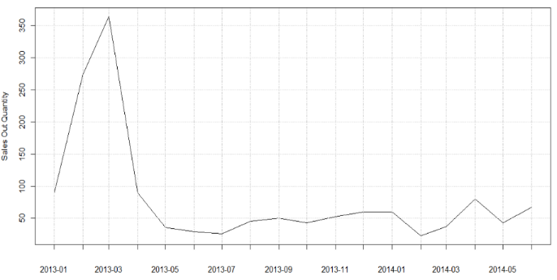
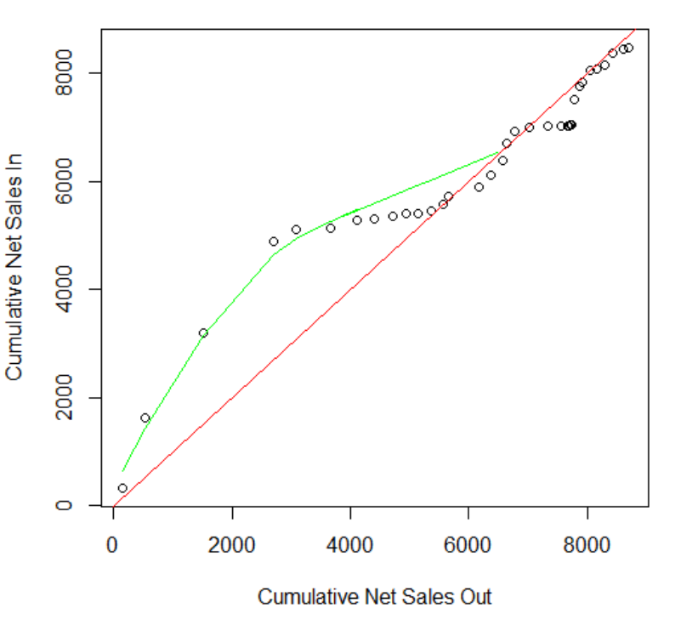
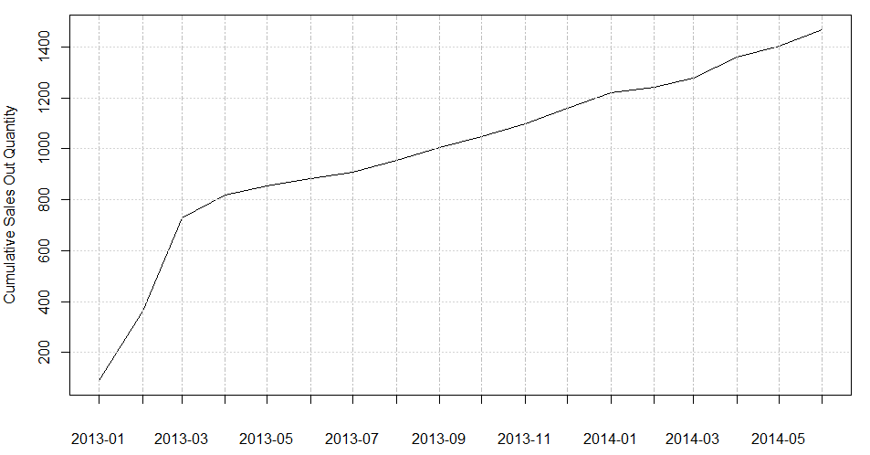
Appendix 2.Forecasting Models - Activyl
(Use SKU 117105: Activyl® TICK PLUS Large Dogs/Puppies 6 X 6 X 4.0ML as an example)
Forecast Sales Out after removing pipeline effects
Analyze Net Sale In and Net Sales Out which are extracted from inventory data
3. Forecast Actual Sale In using the model of Net Sales In
Initial Sales Out fed into Vets’ pipeline
Sales Out dispensed by Vets
Pipeline Stage
Notes:
A

Slide 16
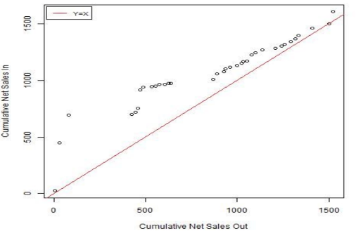
Appendix 3.Activyl Sales In – Inventory Analysis
For the 4 SKUs of Extra Large Dogs:
Sales In follows a zig-zag shape - Quantities are strongly influenced by market demand instead of historical values - These SKUs should be modeled individually.
SKU 114997
Extra Large Dogs/Puppies 22 X 1 X 4.62ML
For the rest 12 SKUs of Dogs and Cats:
Pack size determines how Sales In behaves:
- Distributors have high expectations for SKUs with pack size 22 X 1
- SKUs with pack size 6 X 6 receives much less attention when they are launched
- Distributors tend to underestimate vets’ demand of these 6 X 6 size
For 8 TICK PLUS SKUs of Dogs :
SKU type determines how Sales In behaves:
- SKUs with the same type but different pack size have similar trends in terms of Sales In.
- Distributors have a mild order policy since the product launch
Notes:
A

Slide 17
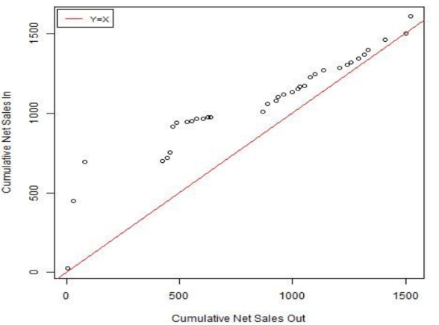
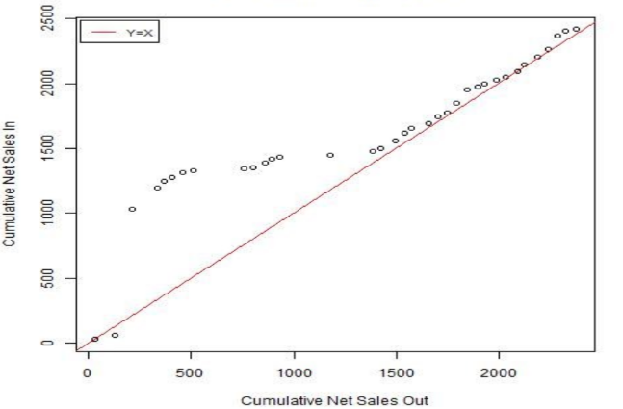
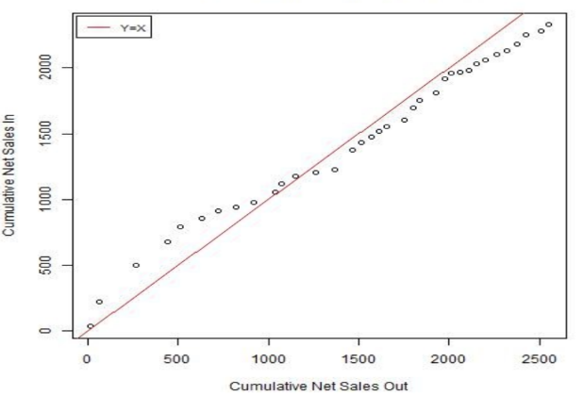
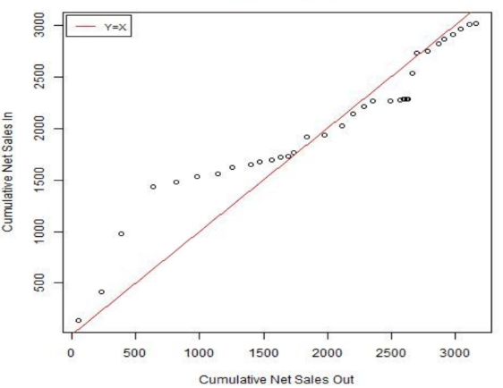
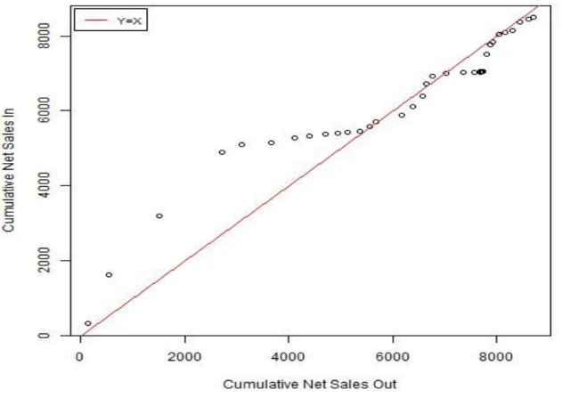
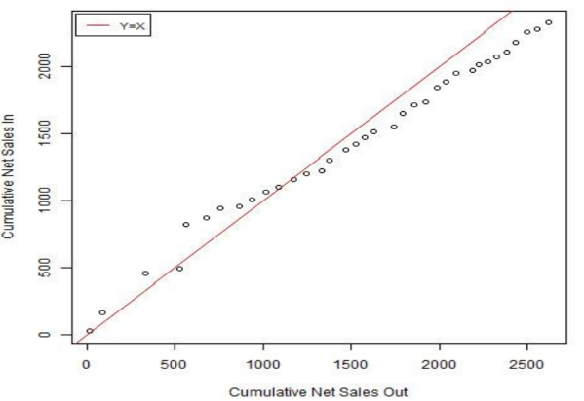
Appendix 3.Activyl Sales In – Inventory Analysis
4.Activyl Sales In – Inventory Analysis
SKU 114997
Extra Large Dogs/Puppies 22 X 1 X 4.62ML
SKU 115236
Activyl® Toy Dogs/Puppies 22 X 1 X 0.51ML
SKU 104482
Activyl® Toy Dogs/Puppies 6 X 6 X 0.51ML
SKU 113408
Activyl® TICK PLUS Large Dogs/Puppies 22 X 1 X 4.0ML
SKU 117105
Activyl® TICK PLUS Large Dogs/Puppies 6 X 6 X 4.0ML
SKU 116338
Activyl® Large Dogs/Puppies 6 X 6 X 3.08ML

Slide 18
Appendix 3– Activyl Time to Maturity – Inventory Analysis
2014 Feb:
Activyl® Toy Dogs/Puppies 6 X 6 X 0.51ML;
Activyl® Small Dogs/Puppies 6 X 6 X 0.77ML;
Activyl® Medium Dogs/Puppies 6 X 6 X 1.54ML;
Activyl® Large Dogs/Puppies 6 X 6 X 3.08ML;
Activyl® Extra Large Dogs/Puppies 6 X 6 X 4.62ML;
Activyl® Kitten 6 X 6 X 0.51ML;
Activyl® TICK PLUS Toy Dogs/Puppies 6 X 6 X 0.5ML
Activyl® TICK PLUS Small Dogs/Puppies 6 X 6 X 1.0ML
Activyl® TICK PLUS Medium Dogs/Puppies 6 X 6 X 2.0ML
Activyl® TICK PLUS Large Dogs/Puppies 6 X 6 X 4.0ML;
Activyl® TICK PLUS Small Dogs/Puppies 22 X 1 X 1.0ML
2014 Apr:
Activyl® Toy Dogs/Puppies 22 X 1 X 0.51ML
Activyl® Medium Dogs/Puppies 22 X 1 X 1.54ML
Activyl® Kitten 22 X 1 X 0.51ML
Activyl® Cats 22 X 1 X 1.0ML
Activyl® TICK PLUS Toy Dogs/Puppies 22 X 1 X 0.5ML
Activyl® TICK PLUS Large Dogs/Puppies 22 X 1 X 4.0ML
2014 Jun:
Activyl® Cats 6 X 6 X 1.0ML
Activyl® TICK PLUS Medium Dogs/Puppies 22 X 1 X 2.0ML
2014 Sep:
Activyl® Small Dogs/Puppies 22 X 1 X 0.77ML
Activyl® Medium Dogs/Puppies 22 X 1 X 1.54ML
Activyl® Large Dogs/Puppies 22 X 1 X 3.08ML
Activyl® TICK PLUS Large Dogs/Puppies 22 X 1 X 4.0ML
Activyl® TICK PLUS Extra LargeDogs/Puppies 22 X 1 X 6.0ML
2015 Apr:
Activyl® Extra Large Dogs/Puppies 22 X 1 X 4.62ML

Slide 19
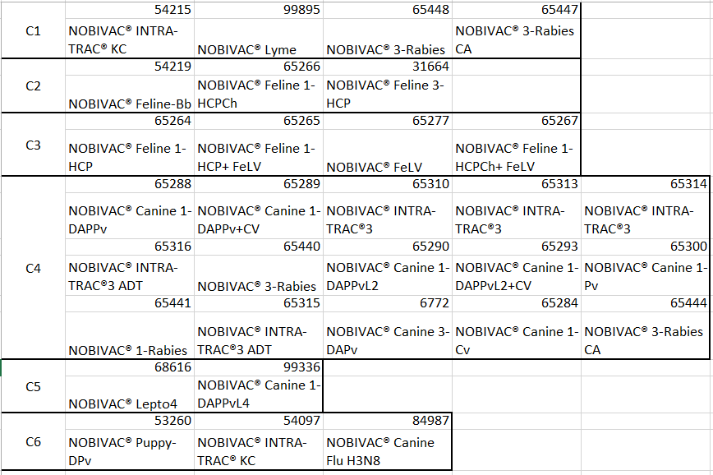
Appendix 4. – Nobivac Clustering
For C6, correlations < 0.5
Recommendation: Model the 3 SKUs individually

Slide 20
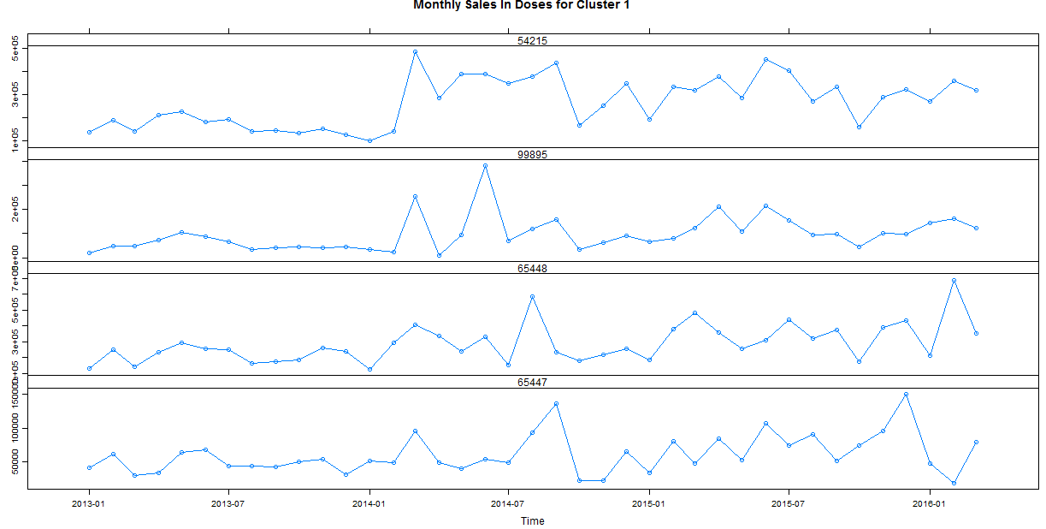
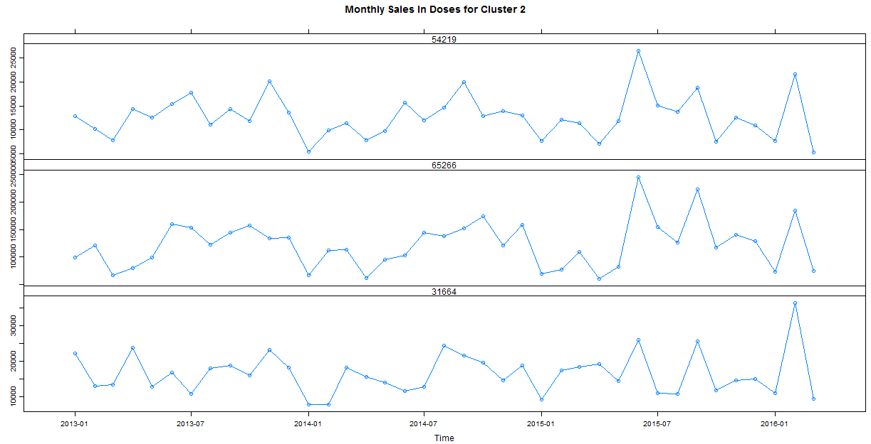
Appendix 4. – Nobivac Clustering

Slide 21
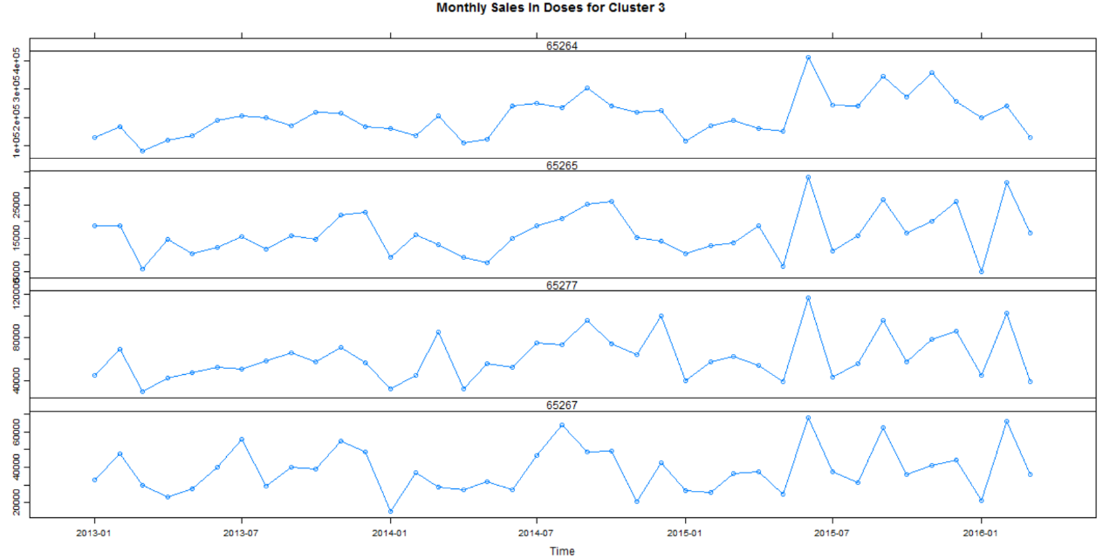
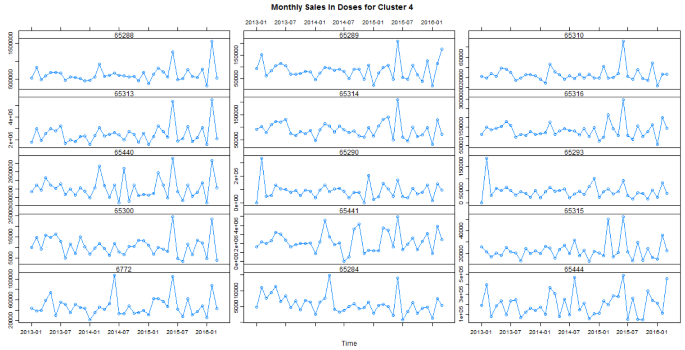
Appendix 4. – Nobivac Clustering

Slide 22
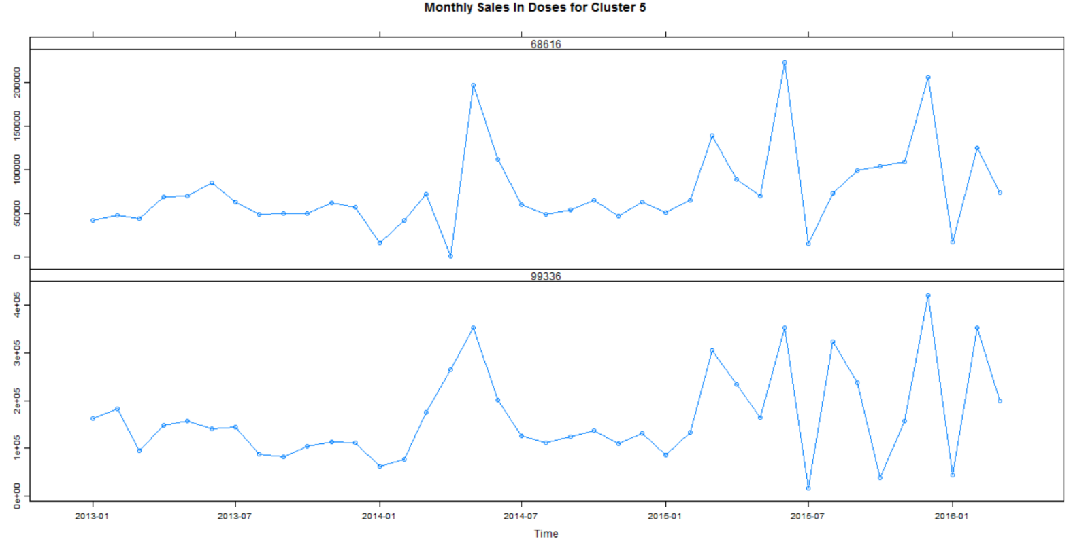
Appendix 4. – Nobivac Clustering

Slide 23
Appendix 5 – Activyl Clustering by Type
Cluster Model 1
C1 | 104482 | 112173 | 107502 | 116338 | 115236 | 113603 | 104695 | 099646
 | Activyl® Toy Dogs/Puppies 6 X 6 X 0.51ML | Activyl® Small Dogs/Puppies 6 X 6 X 0.77ML | Activyl® Medium Dogs/Puppies 6 X 6 X 1.54ML | Activyl® Large Dogs/Puppies 6 X 6 X 3.08ML | Activyl® Toy Dogs/Puppies 22 X 1 X 0.51ML | Activyl® Small Dogs/Puppies 22 X 1 X 0.77ML | Activyl® Medium Dogs/Puppies 22 X 1 X 1.54ML | Activyl® Large Dogs/Puppies 22 X 1 X 3.08ML
C2 | 044973 | 118926 | 106980 | 026072
 | Activyl® Kitten 6 X 6 X 0.51ML | Activyl® Cats 6 X 6 X 1.0ML | Activyl® Kitten 22 X 1 X 0.51ML | Activyl® Cats 22 X 1 X 1.0ML
C3 | 111632 | 104721 | 108760 | 117105 | 090869 | 113314 | 119643 | 113408
 | Activyl® TICK PLUS Toy Dogs/Puppies 6 X 6 X 0.5ML | Activyl® TICK PLUS Small Dogs/Puppies 6 X 6 X 1.0ML | Activyl® TICK PLUS Medium Dogs/Puppies 6 X 6 X 2.0ML | Activyl® TICK PLUS Large Dogs/Puppies 6 X 6 X 4.0ML | Activyl® TICK PLUS Toy Dogs/Puppies 22 X 1 X 0.5ML | Activyl® TICK PLUS Small Dogs/Puppies 22 X 1 X 1.0ML | Activyl® TICK PLUS Medium Dogs/Puppies 22 X 1 X 2.0ML | Activyl® TICK PLUS Large Dogs/Puppies 22 X 1 X 4.0ML

Slide 24
Appendix 5 – Activyl Clustering by Size
Cluster Model 2
C1 | 104482 | 112173 | 107502 | 116338 | 044973 | 118926 | 115236 | 113603
 | Activyl® Toy Dogs/Puppies 6 X 6 X 0.51ML | Activyl® Small Dogs/Puppies 6 X 6 X 0.77ML | Activyl® Medium Dogs/Puppies 6 X 6 X 1.54ML | Activyl® Large Dogs/Puppies 6 X 6 X 3.08ML | Activyl® Kitten 6 X 6 X 0.51ML | Activyl® Cats 6 X 6 X 1.0ML | Activyl® Toy Dogs/Puppies 22 X 1 X 0.51ML | Activyl® Small Dogs/Puppies 22 X 1 X 0.77ML
 | 104695 | 099646 | 106980 | 026072 | 111632 | 104721 | 108760 | 117105
 | Activyl® Medium Dogs/Puppies 22 X 1 X 1.54ML | Activyl® Large Dogs/Puppies 22 X 1 X 3.08ML | Activyl® Kitten 22 X 1 X 0.51ML | Activyl® Cats 22 X 1 X 1.0ML | Activyl® TICK PLUS Toy Dogs/Puppies 6 X 6 X 0.5ML | Activyl® TICK PLUS Small Dogs/Puppies 6 X 6 X 1.0ML | Activyl® TICK PLUS Medium Dogs/Puppies 6 X 6 X 2.0ML | Activyl® TICK PLUS Large Dogs/Puppies 6 X 6 X 4.0ML
C2 | 115236 | 113603 | 104695 | 099646 | 090869 | 113314 | 119643 | 113408
 | Activyl® Toy Dogs/Puppies 22 X 1 X 0.51ML | Activyl® Small Dogs/Puppies 22 X 1 X 0.77ML | Activyl® Medium Dogs/Puppies 22 X 1 X 1.54ML | Activyl® Large Dogs/Puppies 22 X 1 X 3.08ML | Activyl® TICK PLUS Toy Dogs/Puppies 22 X 1 X 0.5ML | Activyl® TICK PLUS Small Dogs/Puppies 22 X 1 X 1.0ML | Activyl® TICK PLUS Medium Dogs/Puppies 22 X 1 X 2.0ML | Activyl® TICK PLUS Large Dogs/Puppies 22 X 1 X 4.0ML

Slide 25
Appendix 5– Activyl Clustering by Size & Type
Cluster Model 3
C1 | 104482 | 112173 | 107502 | 116338
 | Activyl® Toy Dogs/Puppies 6 X 6 X 0.51ML | Activyl® Small Dogs/Puppies 6 X 6 X 0.77ML | Activyl® Medium Dogs/Puppies 6 X 6 X 1.54ML | Activyl® Large Dogs/Puppies 6 X 6 X 3.08ML
C2 | 044973 | 118926
 | Activyl® Kitten 6 X 6 X 0.51ML | Activyl® Cats 6 X 6 X 1.0ML
C3 | 115236 | 113603 | 104695 | 099646
 | Activyl® Toy Dogs/Puppies 22 X 1 X 0.51ML | Activyl® Small Dogs/Puppies 22 X 1 X 0.77ML | Activyl® Medium Dogs/Puppies 22 X 1 X 1.54ML | Activyl® Large Dogs/Puppies 22 X 1 X 3.08ML
C4 | 106980 | 026072
 | Activyl® Kitten 22 X 1 X 0.51ML | Activyl® Cats 22 X 1 X 1.0ML
C5 | 111632 | 104721 | 108760 | 117105
 | Activyl® TICK PLUS Toy Dogs/Puppies 6 X 6 X 0.5ML | Activyl® TICK PLUS Small Dogs/Puppies 6 X 6 X 1.0ML | Activyl® TICK PLUS Medium Dogs/Puppies 6 X 6 X 2.0ML | Activyl® TICK PLUS Large Dogs/Puppies 6 X 6 X 4.0ML
C6 | 090869 | 113314 | 119643 | 113408
 | Activyl® TICK PLUS Toy Dogs/Puppies 22 X 1 X 0.5ML | Activyl® TICK PLUS Small Dogs/Puppies 22 X 1 X 1.0ML | Activyl® TICK PLUS Medium Dogs/Puppies 22 X 1 X 2.0ML | Activyl® TICK PLUS Large Dogs/Puppies 22 X 1 X 4.0ML

Slide 26
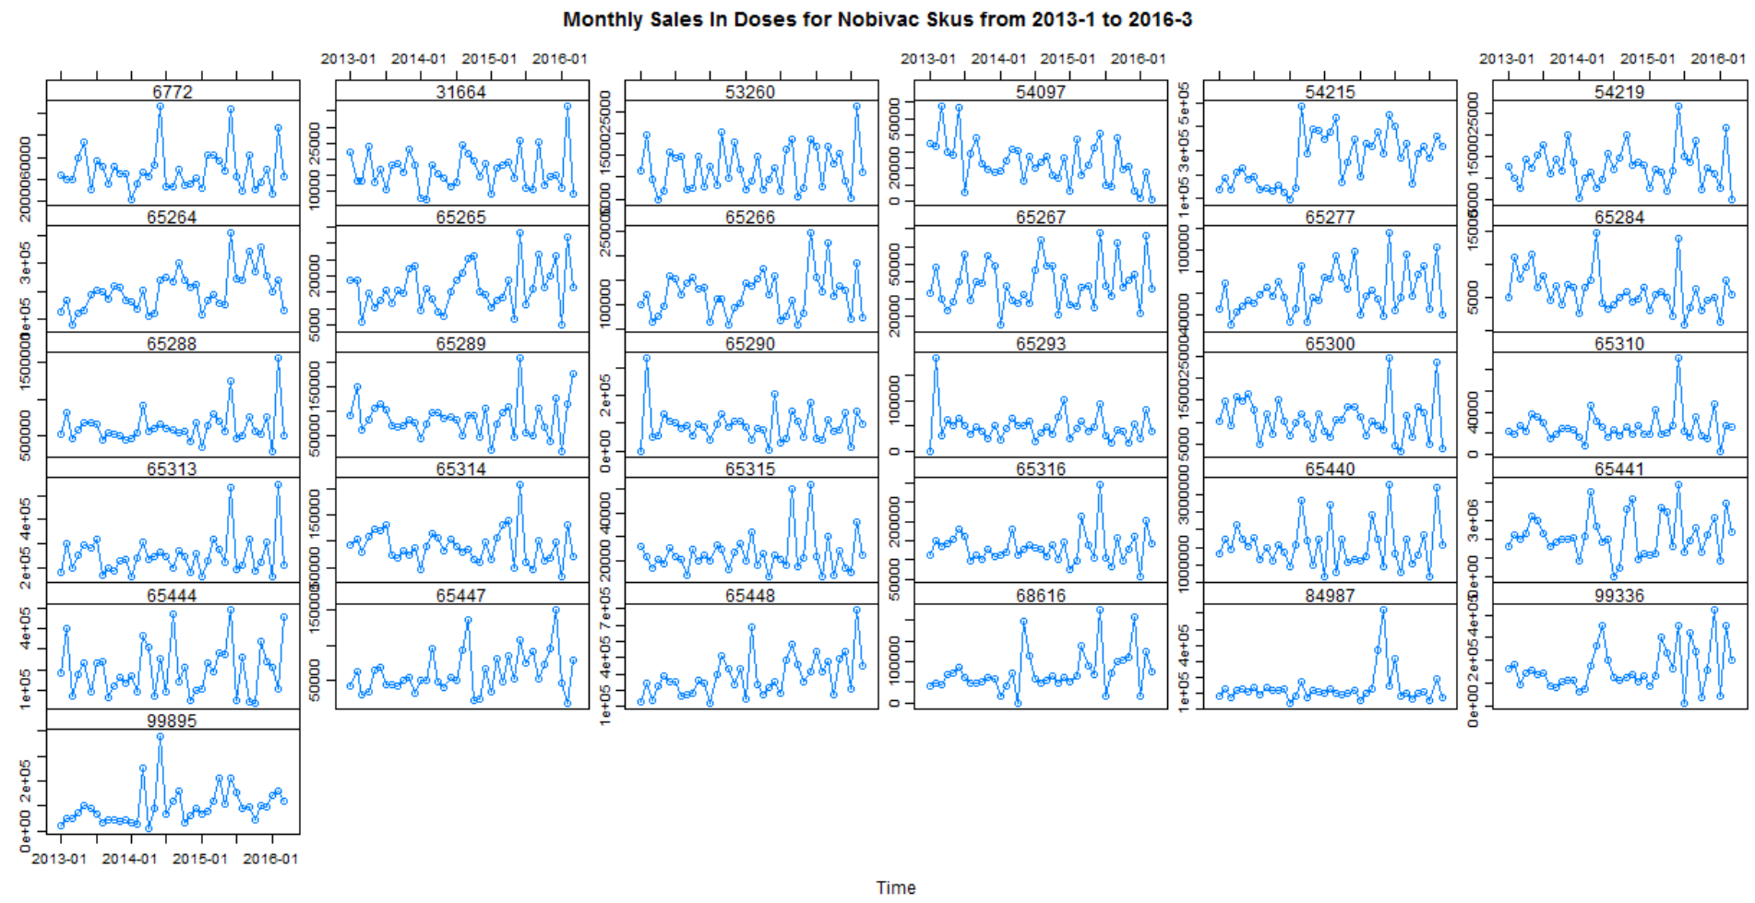
Appendix 6– Nobivac Trend

Slide 27
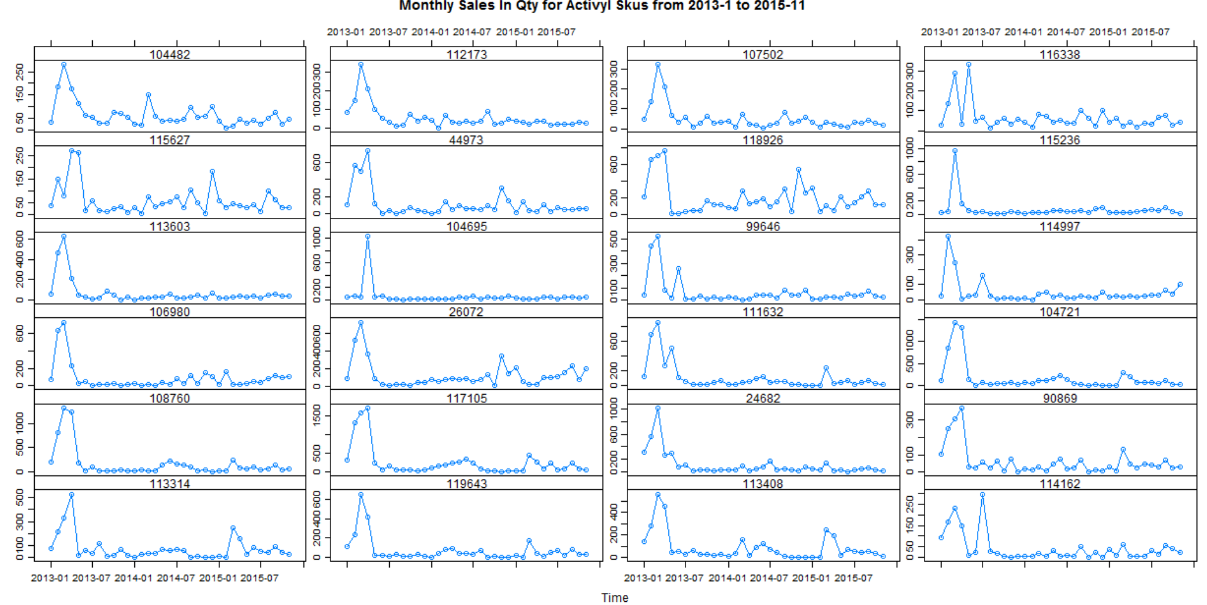
Appendix 7– Activyl Trend

